Slide 1


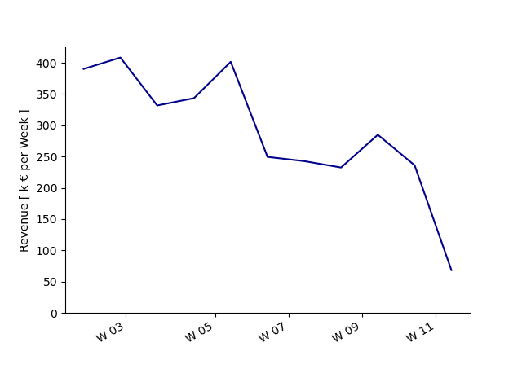
REVENUE IN Q1 2018
WAS IT THE DISCOUNT?
Included data: Jan 2017 - Mar 2018

Slide 2
Revenue Decreased to 25% in 2018
400 k €
100 k €

Slide 3
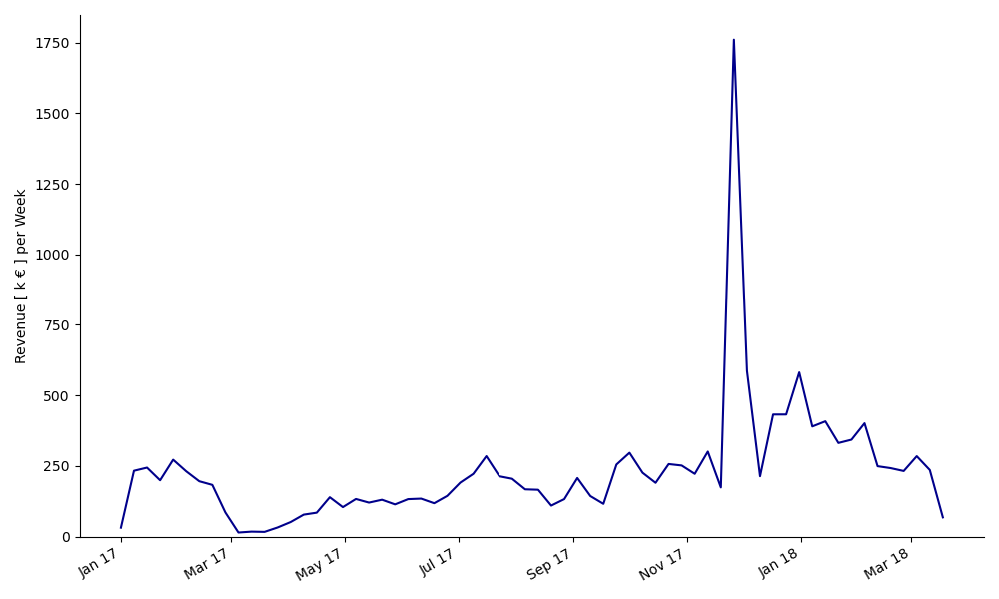
Overall Revenue is Stable
1800 k €
300 k €
230 k €
Average Revenue per week
125 k €
Notes:
Revenue generally is steady. Average revenue 230 k €
Strong increase during Black friday. Last decrease only relative to that

Slide 4

DISCOUNT
DOES IT INFLUENCE REVENUE?

Slide 5
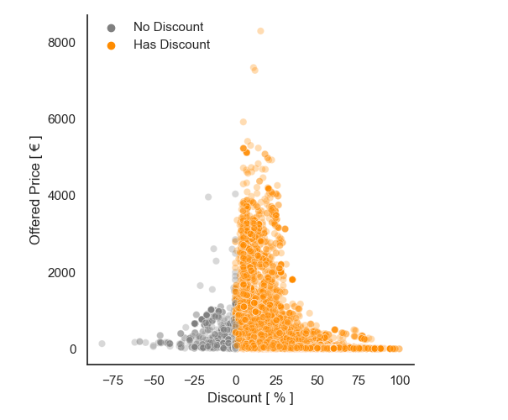
93 % of all Sales are Discounted
Notes:
93 % of all sales are discounted
7 % negative discounts - this highlights the need for a price history to show concise influence of discounts

Slide 6
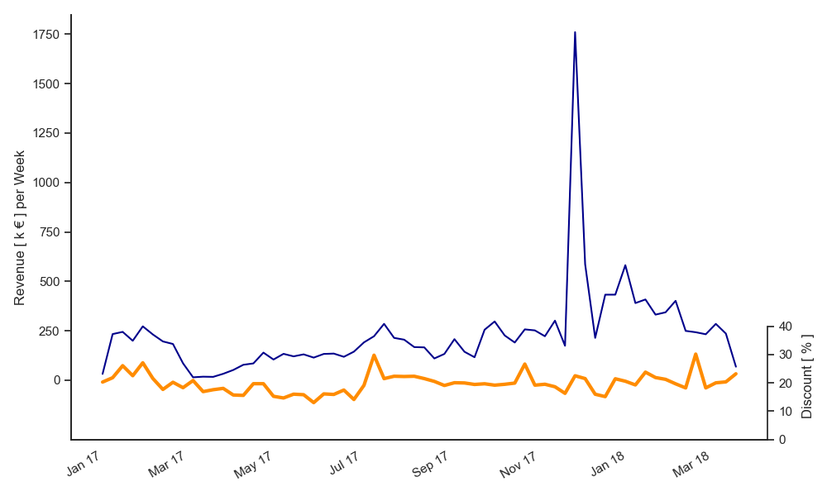
Revenue Develops Independent from Discount
30 %
20 %
Average Discount
10 %
Notes:
Revenue in blue, as before. Discount (%) in orange.
Products are continuously discounted. 20% Average discount.
Revenue develops rather independently. Highlight black friday

Slide 7
CATEGORIES
HIGHER DISCOUNT = LOWER REVENUE?

Slide 8
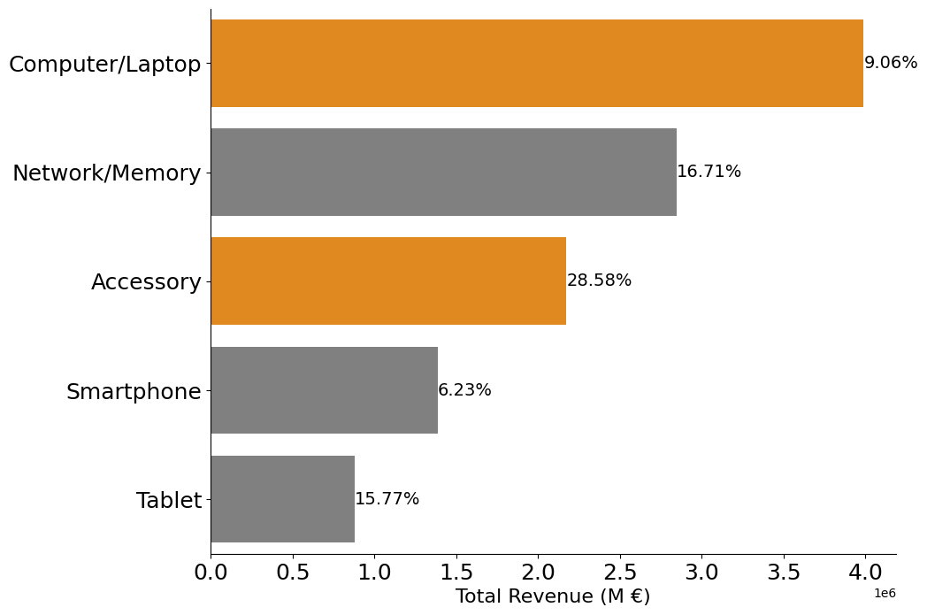
Top Five Categories with Highest Revenue
Notes:
Top 5 categories in term of revenue
Whats the relationship to discounts?

Slide 9
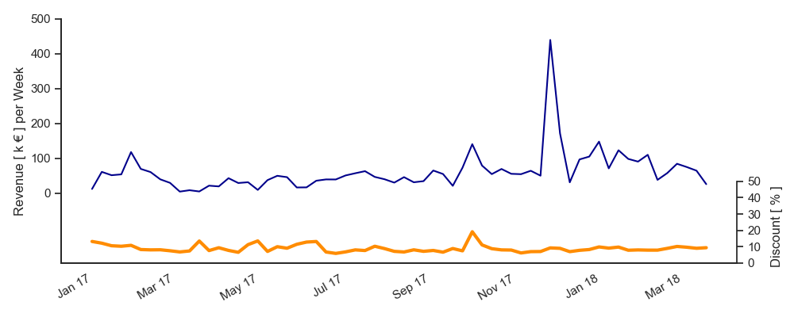
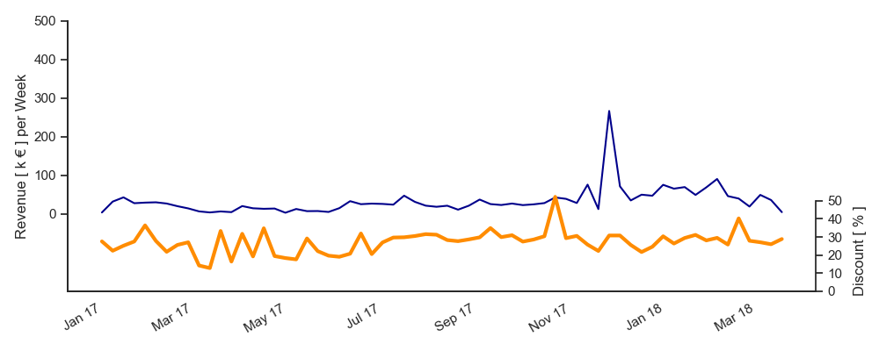
High Discount for Accessoires, Low Discounts for High-Tech Gear
Computer/Laptop
450 k €
9 %
Average Discount
27 %
62 k €
Average Revenue
per Week
33 k €
15%
5 %
Accessoires
250 k €
50 %
10 %
Notes:
low discount products are usually high priced and generate high Revenue than
high discount products are low priced and generate less Revenue

Slide 10
CONCLUSION
WAS IT THE DISCOUNT?

Slide 11
DISCOUNTS IMPACT POSITIVELY - FURTHER DATA IS NEEDED
CONCLUSION
Revenue generally stable
Most products are continuously discounted
Highest revenue from low-discount products
POTENTIAL FOR IMPROVED DATA INSIGHTS
History of recommended prices
Information about clients
Missing data in Mar & Apr 2017

Slide 12

included data: Jan 2017 - Mar 2018

Slide 13
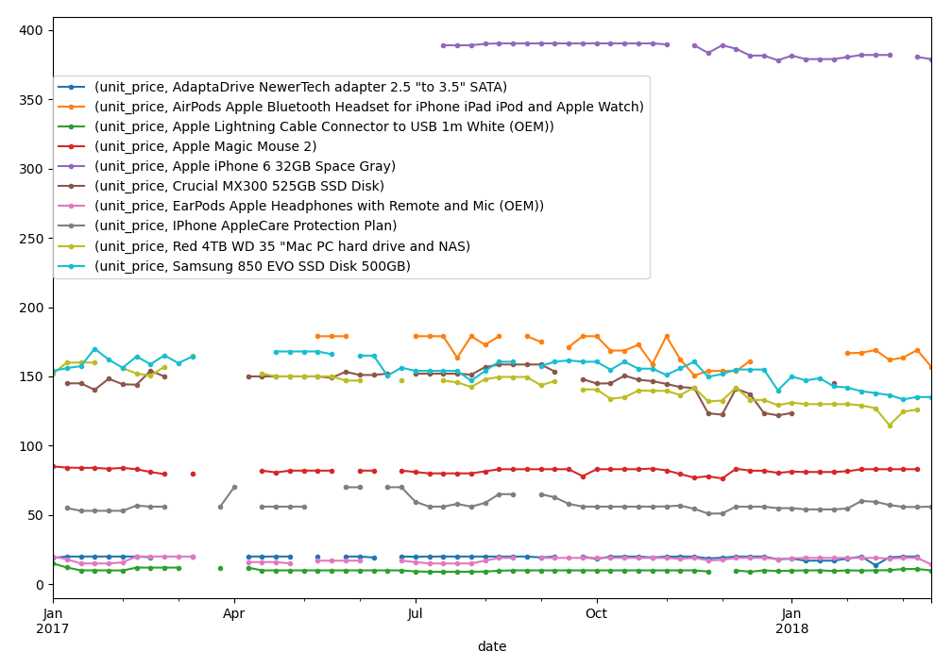

Slide 14
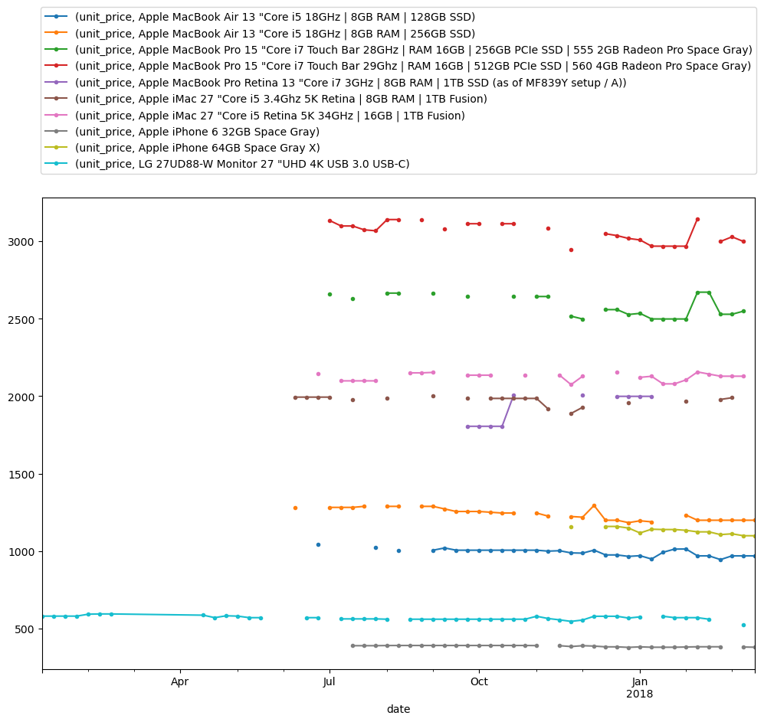

Slide 15
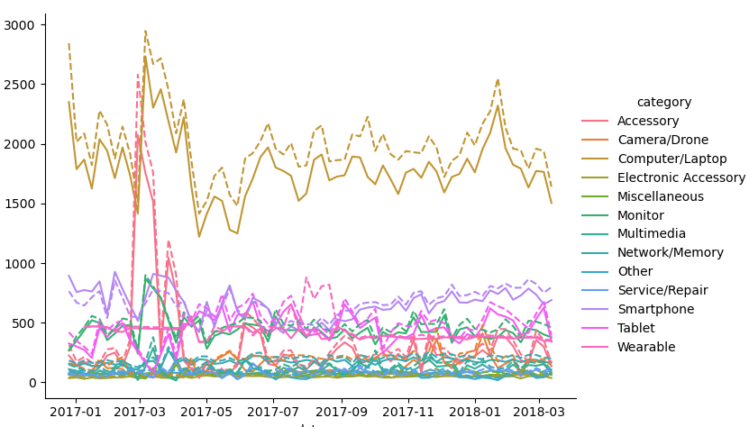

Slide 16
Exclusion path
20% of data is included
entries / tables | orders | orderlines | products
original | 226909 | 293983 | 19326
duplicates and NAs | 226904 | 293977 | 10534
un-related order and product IDs | 196210 | 278060 | 9992
complete purchases only | 44865 (19.8%) | 59073 (20.1%) | 9992 (51.7%)

Slide 17
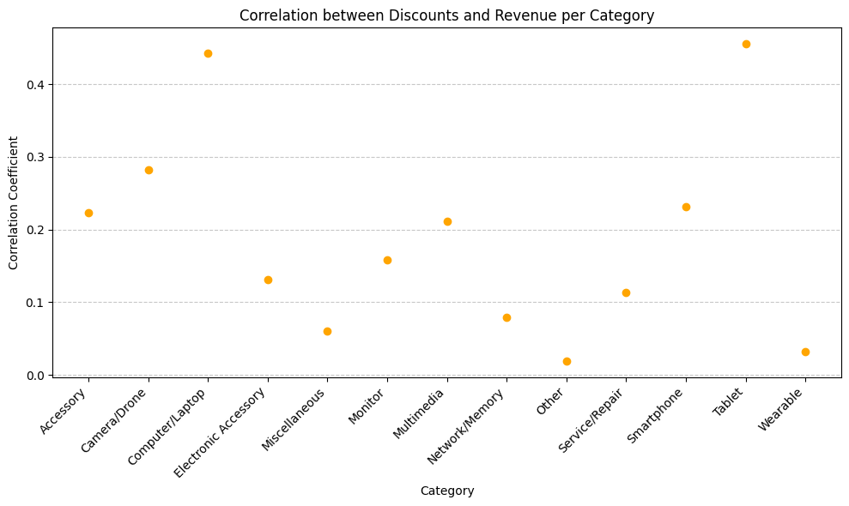
Aggressive Discounts = more Revenue?
Notes:
Our Definition of mild medium and high/agressive discount?
Plot: Correlation between Discounts and Revenue per category - example categories for (explain some numbers and defend the arguments)
remove

Slide 18
REVENUE
GENERAL DEVELOPMENT
Included data: Jan 2017 - Mar 2018

